Slide 1
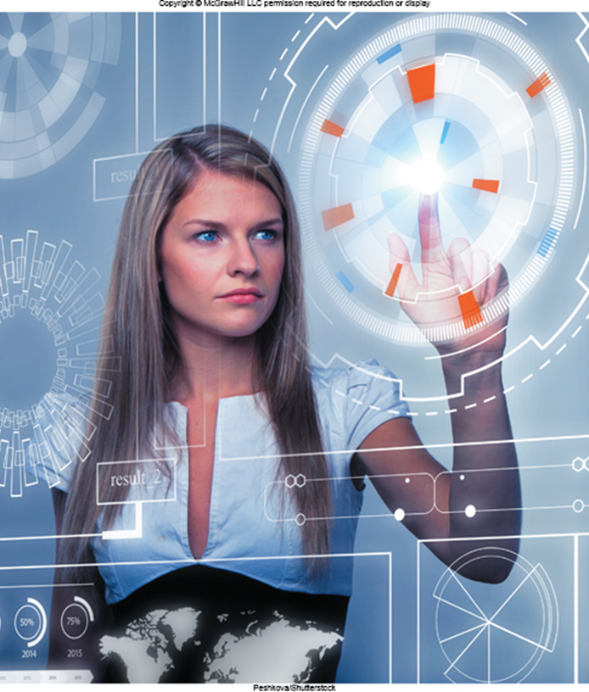
Chapter 6
Input and Output
Computing Essentials 2023
O’Leary
© McGraw Hill LLC. All rights reserved. No reproduction or distribution without the prior written consent of McGraw Hill LLC.
Notes:
The chapter introduces you to how to protect your computer and data today and prepare you for tomorrow including keyboard design, input devices, display technology, and output devices.

Slide 2
Learning Objectives
Define input.
Describe keyboard entry, including types and features of keyboards.
Identify different pointing devices, including game controllers and styluses.
Describe scanning devices, including optical scanners, R F I D readers, and recognition devices.
Recognize image capturing and audio-input devices.
Define output.
Identify different monitor features and types, including flat-panels and e-books.
Define printing features and types, including inkjet and cloud printers.
Recognize different audio and video devices, including portable media devices.
Define combination input and output devices, including multifunctional devices, V R head-mounted displays and controllers, drones, and robots.
Explain ergonomics and ways to minimize physical damage.
Notes:
Review the Learning Objectives with students to help them understand what they need to get from the chapter.

Slide 3
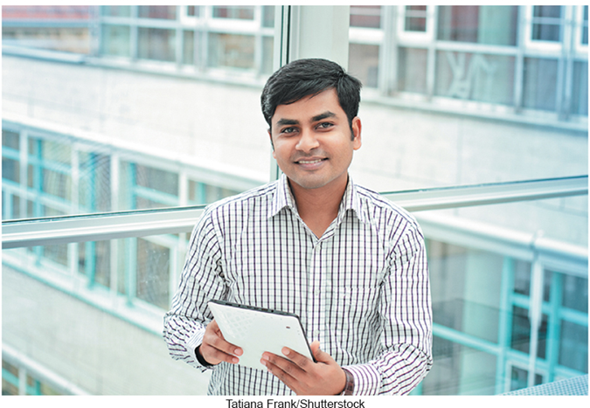
Introduction
Have you ever wondered how information gets into your computer and comes out in a form you can use?
Input devices convert what we understand into what the system unit can process.
Output devices convert what the system unit has processed into a form that we can understand.
gstockstudio/123RF

Slide 4
What is Input?
Any data or instructions entered into a computer.
Input devices translate data into a form that the system unit can process.
Some hardware input devices include:
Keyboards.
Mice.
Pointing.
Scanning.
Image capturing.
Audio-input.
Notes:
Input (key term)
Input devices (key term) are hardware used to translate words, sounds, images, and actions that people understand into a form that the computer can understand
Input allows user to put their information into computer language
Most common are keyboard, mouse, scanning devices, image capturing devices and audio-input devices

Slide 5
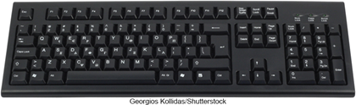

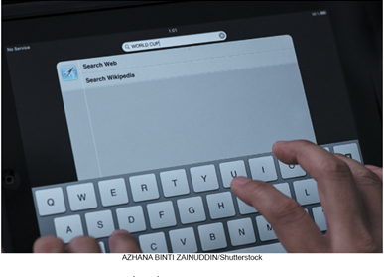
Keyboard Entry
Traditional Keyboard.
Laptop Keyboard.
Virtual Keyboard.
Justin Sullivan/Getty Images ; Rawpixel.com/Shutterstock ; Georgios Kollidas/Shutterstock
Notes:
Keyboards (key term) come in a variety of designs – most common way to input data
Range from full-sized to miniature and from rigid to flexible
Common types
Virtual keyboard (key term) – keyboard for a tablet PC and mobile devices– shown on a touch screen
Laptop keyboard (key term) – used on laptop computers
Traditional keyboard (key term) – full sized, rigid, rectangular keyboards that include function, navigational, and numeric keys

Slide 6
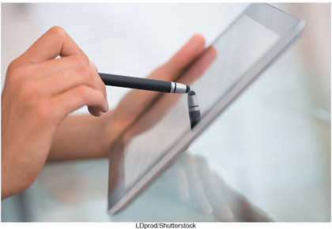

Pointing Devices
Provide an intuitive interface by accepting pointing gestures and converting them into machine-readable input.
Wide variety of devices such as:
Mouse.
Touch screen.
Game controller.
Notes:
Pointing Devices (key term) provide an intuitive interface by accepting pointing gestures and converting them into machine-readable input

Slide 7
Mouse Types
Optical mouse.
Has no moving parts.
Emits and senses light to detect mouse movement.
Can be used on any surface.
Wireless mouse.
Battery operated.
Uses radio waves or infrared light waves.
Touch pads.
Controls pointer by moving and tapping your fingers on the surface of the pad.
Notes:
Mouse (key term) controls a mouse pointer (key term) that appears in the shape of an arrow
Some mice have a wheel button (key term) for scrolling. The Optical Mouse (key term) is the most widely used
Mouse types
Optical mouse (Key Term) – has no moving parts
Emits and senses light to detect mouse movement
Can be used on any surface
Cordless mouse (Key Term) or wireless mouse (Key Term) – battery powered
Uses radio waves or infrared light waves
Touch pads (key term) –controls the pointer by moving and tapping your fingers on the surface of a pad

Slide 8
Touch Screen
Can be touched with more than one finger.
Stylus is a pen-like device.
Used on tablets.
Uses handwriting recognition software.
Notes:
Multi-touch screen (key term) – can be touched with more than one finger, which allows for interactions such as rotating graphical objects on the screen with your hand or zooming in and out by pinching and stretching your fingers.
Stylus (key term) works using handwriting recognition software. It is a pen-like device.

Slide 9
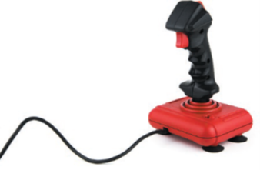
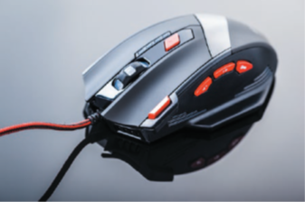
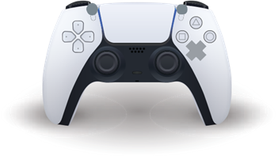
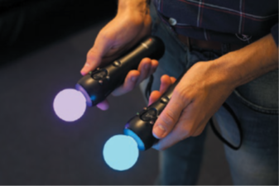
Gaming Controllers
Provide input to computer games.
Joysticks use pressure and direction of the stick.
Gaming mice are similar to a mouse but high precision.
Gamepads use both hands.
Motion sensing device control games by user movement.
Lucidio Studio Inc/Photographer’sChoice/Getty Images; Geostock/Getty Images
Notes:
Joystick (key term)– control game actions by varying pressure, speed and direction
Gaming Mouse – similar to traditional mice with higher precision, faster responsiveness, programmable buttons, and better ergonomics
Gamepads (key term) – held by two hands
Motion sensing device (key term) – control games by user movement

Slide 10
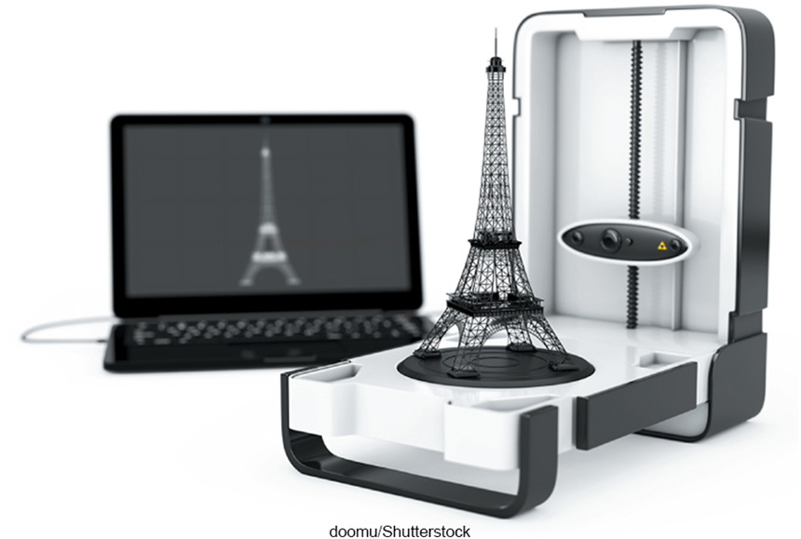
Scanning Devices
Scanners convert scanned data into a form the system unit can process.
Optical scanners.
Flatbed scanners.
Document scanners.
Portable scanners.
3D scanners.
Alexander Kharchenko/123RF
Notes:
Scanning devices (key term) convert scanned data into a form the system unit can process
Types
Optical (key term) – known as a scanner (key term)
Recognizes light, dark, and colored areas that make up individual letters or images
Types
Flatbed (key term)– much like a copy machine
Document (key term)– similar to flatbed except that it can quickly scan multipage documents; automatically feeds one page of a document at a time
Portable (key term)– typically a handheld device that slides across the image making direct contact
3D (key term) – uses lasers, cameras, or robotic arms to record the shape of an object

Slide 11
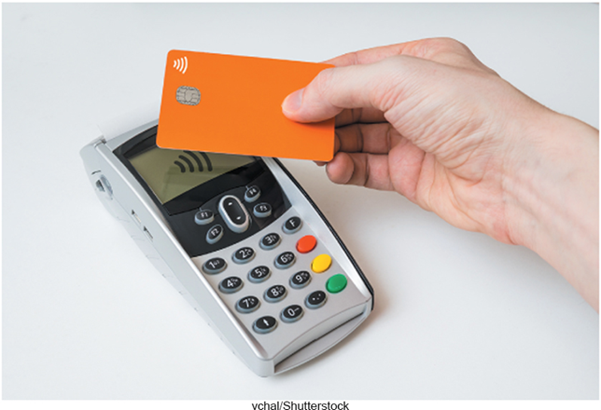
Card Readers
Interpret encoded information that is stored on debit, credit and identification cards.
Magnetic card reader.
Information read from strip when swiped through reader.
Chip card reader.
Information read from a chip when inserted or held near the reader.
Smart cards hold additional security information.
Notes:
Card Readers (key term) interpret encoded information that is stored on debit, credit, and identification cards
Magnetic card reader (Key Term) – information is stored on a thin magnetic strip on the back of a card; is read when swiped through a card reader
Chip card (key term) -
include additional security in the form of a microchip embedded in
the credit card. This chip contains encrypted data that makes it nearly
impossible for criminals to forge a duplicate card.

Slide 12
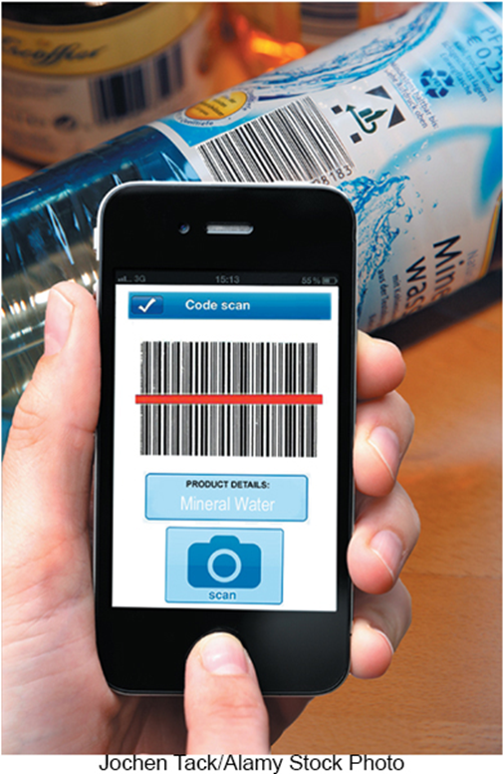
Bar Code Readers
Contain photo-electric cells that scan or read bar codes or the zebra striped marks printed on product containers.
U P Cs and MaxiCode readers.
U P C are heavily used in grocery stores for automated checkout and inventory control.
MaxiCode used by shipping companies for routing packages.
Cell phones with app can also scan codes.
Notes:
Bar code readers or bar code scanners (Key Term)
You see these devices at the grocery store
Wand reader (key term) or platform scanner (key term)
Reads bar codes or vertical zebra striped marks printed on product containers
Products have a UPC (Universal Product Code) (Key Term)
MaxiCode (key term) used for routing and tracing packages
Cell phones with the appropriate apps can also scan bar codes.

Slide 13
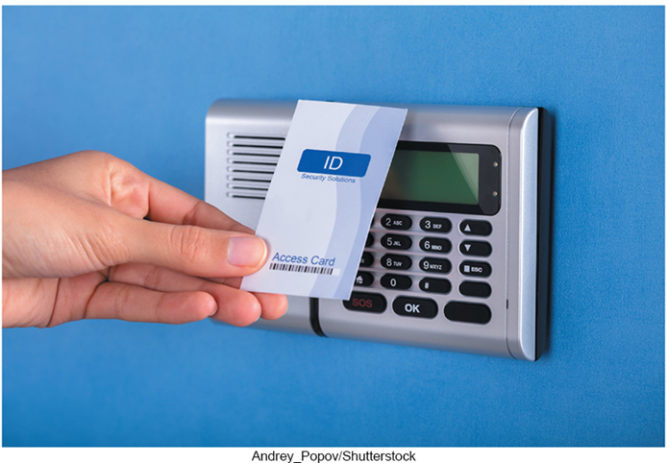
RFID Readers
Radio-frequency identification.
Tiny chips embedded in most anything contain electronically stored information that can be read using an RFID reader located several yards away.
Tracking pets.
Update and control inventories.
Read passports.
Jochen Tack/imageBROKER/Shutterstock
Notes:
RFID (radio frequency identification) (key term) tags are tiny chips embedded for tracking in most anything.
They contain electronically stored information that can be read using an RFID readers
Read by RFID readers (key term)

Slide 14
Character & Mark Recognition Readers
Recognize special characters and marks.
Character and mark recognition devices.
Magnetic-ink character recognition (M I C R).
Used by banks to read encoded characters on checks.
Optical-character recognition (O C R).
Reads preprinted characters such as wand scanners.
Optical-mark recognition (O M R).
Sense the presence of absence of marks used for test scoring.
Notes:
Character and mark recognition devices are scanners that recognize special characters & marks
MICR (key term)– used by banks to read magnetically encoded characters on the bottom of checks and deposit slips; numbers are read by a reader/sorter
OCR (key term)– specially preprinted characters are read by OCR devices such as wand scanners, read price tags
OMR (key term) (also called mark sensing) – devices sense the presence or absence of marks, common for standardized multiple choice test scoring

Slide 15

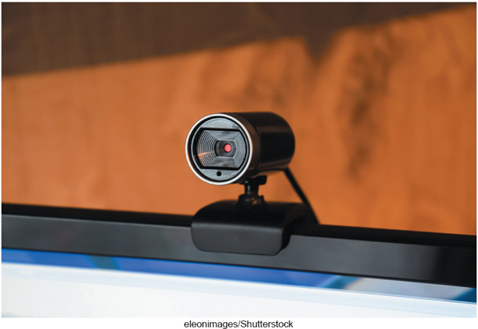
Image Capturing Devices
Create or capture original images.
Digital Camera.
Capture images digitally and store in memory.
Webcams.
Capture images and send to a computer for broadcast over the Internet.
Sandra Dombrovsky/123RF; Harald Richter/Pixpack/123RF
Notes:
Imaging capturing devices create or capture original images
Digital cameras (key term) – similar to traditional cameras except images are recorded digitally on disk or a camera’s memory
Webcams (key term) – also referred to as web cameras are specialized digital video cameras that capture images and send them to a computer to broadcast over the Internet
Built into smartphones and tablets

Slide 16
Audio-Input Devices
Voice recognition systems.
Use a microphone, sound card, and special software.
Users can operate computers and create documents using voice commands.
Included in many smart phones.
Siri in iPhones.
Cortana in Windows devices.
Alexa in Amazon devices.
Google Assistant in Android devices.
Notes:
Audio output devices convert sound into a form that can be processed by the system unit
Microphone is the most popular device
Voice recognition systems (key term)
Microphone, bundled with sound card and software
Some can translate from one language to another
Comes as a standard in smart phones

Slide 17
Output
Processed data or information.
Types of output.
Text.
Graphics/photos.
Audio & video.
Output devices.
Monitors.
Printers.
Audio-output devices.
Notes:
Output (key term) is process data or information
Converts machine-readable information into people-readable form
Most common output types – text, graphics, photos, audio, and video
Output device (key term) is any hardware used to provide or to create output
The most widely used output devices (key term) are monitors, printers, and audio-output devices

Slide 18
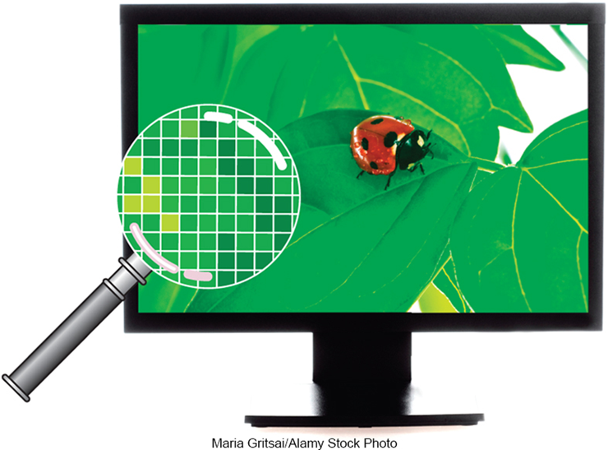
Monitors
Known as screens or display screens, and present visual images of text and graphics.
Features:
Clarity.
Resolution/pixels.
Dot pitch.
Contrast ratios.
Active display area, or size.
Aspect ratio.
Maria Gritsai/Alamy Stock Photo
Notes:
Monitors (key term) are commonly called display screens (Key Term)
Features – most important is clarity
Clarity (key term) – quality and sharpness of the displayed images
Resolution (key term) – one of the most important features; images are formed on a monitor by a series of dots or pixels (picture elements) (Key Term)
Dot (pixel) pitch (Key Term) – the distance between each pixel; most newer monitors have a dot pitch of .30 mm (30/100th of a millimeter) or less
Contrast ratios (key term) – monitor’s ability to display images, compares light intensity of brightest white and darkest black. The higher the ratio, the better the monitor: typically above 1000:1
Active display area (key term) – or size, is measured by the diagonal length of a monitor’s viewing area
Common sizes are 15, 17, 19, 21, and 24 inches
Aspect ratio (key term)– determined by the width of a monitor divided by its height. Common aspect ratios for monitors are 4:3 (standard) and 16:9 (wide screen).

Slide 19
Monitor Types
Flat-panel monitors.
Require less power to operate.
Portable and thin.
Most are backlit.
Three types:
Liquid Crystal Display (L C D).
Older monitors.
Light Emitting Diode (L E D).
More advanced backlighting.
Organic Light Emitting Diode (O L E D).
Thin layer organic compound that produces light.
Simon Belcher/Alamy Stock Photo
Notes:
Flat-Panel Monitors (key term) – are most widely used.
Require less power to operate
Portable and thin
Most are backlit

Slide 20
E-book Readers
An e-book is a traditional books printed in electronic form.
E-book readers are dedicated mobile devices for storing and displaying e-books.
Use e-ink technology.
Produce images that reflect light.
Kindle.
Kobo.
Notes:
E-books (key term) are traditional books printed in electronic form
E-books are read using an e-book reader (key term)
E-book readers are dedicated mobile devices for storing and displaying e-books.
Use e-ink (key term) technology that produces images that reflect light
Amazon’s Kindle
Walmart’s Kobo

Slide 21
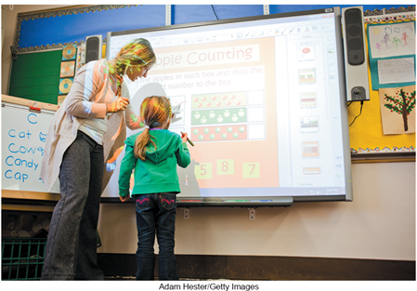
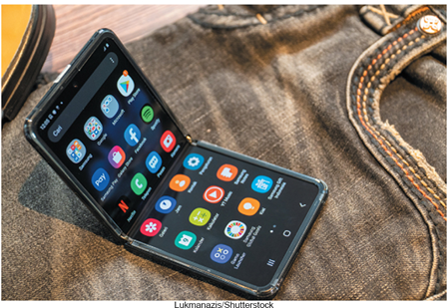
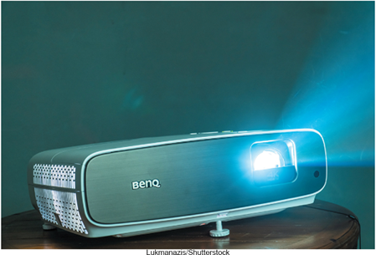
Other Monitor Types
Digital/interactive whiteboards.
Connects to a computer or project.
Controlled using a special pen or even your finger.
Classrooms and corporate boardrooms.
Flexible Screens.
Allow a digital device to display on a non flat surface, including wrapped edges, curved monitors and foldable screens.
Digital Projector.
Project the images from a traditional monitor onto a screen or wall.
Gerald Martineau/The Washington Post/Getty Images; Simon Nagel/dpa picture alliance/Alamy Stock Photo; ; Michal_edo/E+/Getty Images
Notes:
Digital whiteboards – specialized devices with a large display connected to a computer or projector. The computer’s desktop is displayed on the digital whiteboard and controlled using a special pen, a finger, or some other type of device. Digital whiteboards are used in classrooms and corporate boardrooms.
Flexible Screens (key term) allow the device to display on a non flat surface. Early uses include screens to wrap around edges, curved monitors, and recently with the introduction of foldable screens
Digital projector (Key term) projects the images from a traditional monitor onto a screen or wall

Slide 22

Printers
Translates information that has been processed by the system unit.
Features.
Resolution.
Color.
Speed.
Memory.
Duplex printing.
Connectivity.
Notes:
Printers (key term) translate information that has been processed by the system unit and present the information on paper
Features
Resolution (key term) – measures the clarity of images produced
Measured in dots-per-inch (dpi) (Key Term)
Most printers use an average of 1200 dpi x 4800 dpi; the higher the dpi, the better the quality of image produced
Color (key term) – more expensive to print in color; usually have the option to print in either color or b/w. Grayscale (key term) images are displayed using shades of gray.
Speed (key term) – measured in the number of pages printed per minute
15-19 pages per minute is the average for a single color page (black); 5-12 pages per minute for color
Memory (key term) – used to store printing instructions and documents waiting to be printed
Duplex printing (key term) – automatic printing on both sides of a sheet of paper
Connectivity – ability of the printer to connect to a network

Slide 23
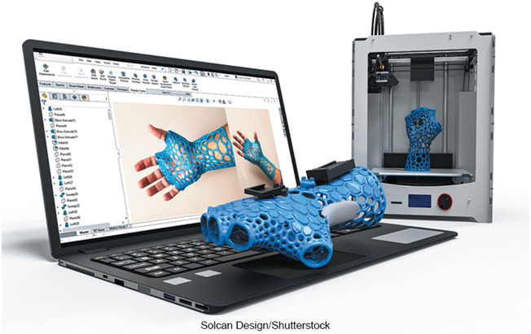
Printer Types
Ink-jet printers spray ink at a high speed.
Reliable, quite and inexpensive.
Laser printers uses a laser light beam to produce images.
Fast, excellent quality.
Personal or shared.
3D Printers create 3-D shapes with a thin layer of material repeatedly until created.
Additive manufacturing.
Aleksei Sysoev/123RF
Notes:
Inkjet printers (key term) spray ink at high speed onto the surface of paper
Reliable, quiet and inexpensive
Laser printers (key term) uses a laser light beam to produce images
Faster, excellent quality and more expensive than ink jet printers
Personal (key term) and shared (key term) laser printers
3D Printers (key term)
Creates 3-dimensional shapes, adds a thin layer of material repeatedly until the item is created

Slide 24
Other Printers
Cloud printers.
Connect to the Internet to provide services to others on the Internet.
Thermal printers.
Plotters.
Notes:
Other Printers
Cloud (key term) – connected to the Internet and provide printing services to others on the Internet. Google Cloud Print is an example. Once a user activates a printers using Google Chrome OS, the user can access the printer anywhere with an Internet connection.
Thermal printers (key term) – uses heat elements to produce images on heat sensitive paper, ATMs and gas pumps
Plotters (key term) – special purpose for maps, images, architectural & engineering drawings

Slide 25
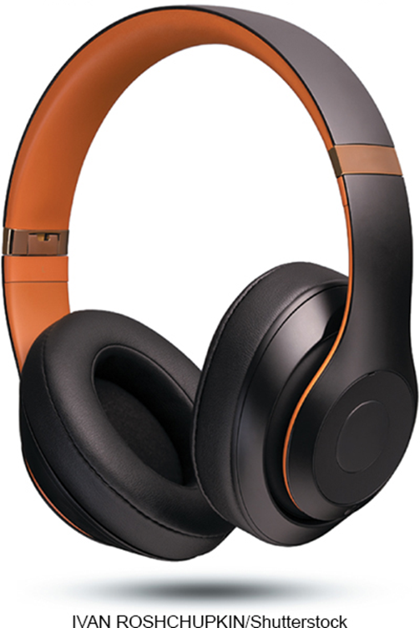
Audio and Video Devices
Translates audio information from the computer into sounds that people can understand.
Speakers and headphones.
Bluetooth Technology.
Wireless technology.
Used to connect to speakers and headphones.
New Africa/Shutterstock
Notes:
Speakers (key term) and headsets (key term) are the most widely used audio-output devices
Connected to a sound card in the system unit
Voice output is quite common; creating voice output is not as difficult as recognizing and interpreting voice input
Bluetooth (key term) technology – wireless technology used to connect speakers and headsets to wireless sound cards

Slide 26
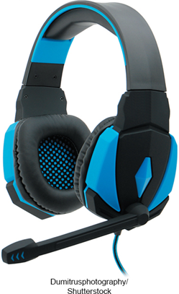
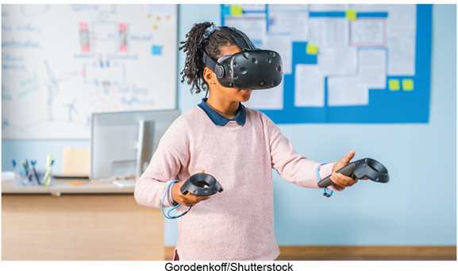
Combination Input and Output Devices
Headsets.
Combine a microphone and headphones.
Multifunctional devices (M F D).
Cost efficient but lower quality.
All-in-one printers are a good example.
Virtual Reality (V R).
Artificial or simulated reality.
Virtual head-mounted displays and controllers.
Jesse Wild/PC Format Magazine/Getty Images; Alexander Tolstykh/123RF
Notes:
Headsets (key term) combine microphone and headphones
Multifunctional devices (MFD) (key term) combine the capabilities of a scanner, printer, fax and copy machine
Usually lower in price and more cost efficient than purchasing the products separately; however the quality is lower
Virtual reality (VR) (key term) is an artificial, or simulated, reality created in 3D by computers
Virtual head-mounted displays (key term) – have earphones for immersive sound, stereoscopic screens to present 3D images, and gyroscopic sensors to interpret head orientation
VR controllers (key term) - have sensors that collect data about your hand movements. Coupled with software, this interactive sensory equipment lets you immerse yourself in a computer-generated world.

Slide 27
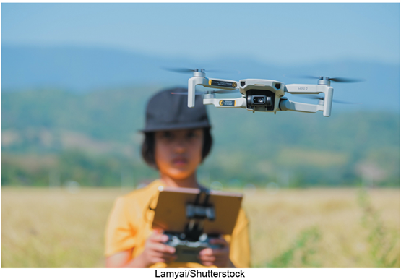
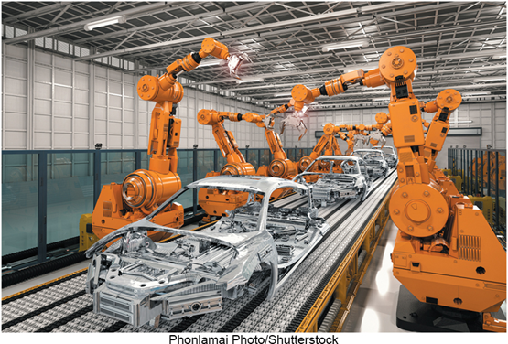
Drones
Drones or unmanned aerial vehicles (U A V).
Take input from a controller and the output device is the drone.
Very cost effective now.
Robots.
Use cameras, microphones, and other sensors as inputs to perform an expanding range of capabilities.
Olga Serdyuk/Microolga/123RF
Notes:
Drones or unarmed aerial vehicles (UAV) (Key term) - take input from a controller and send video and sound back to the user.
They are now more cost effective
Robots (key term) - use cameras, microphones, and other sensors as inputs.

Slide 28
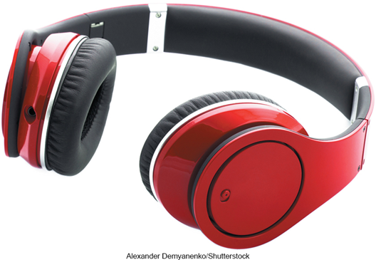
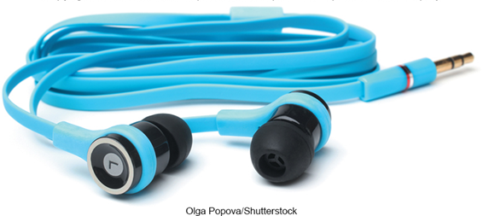
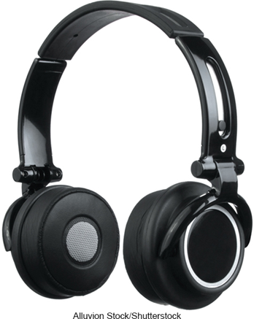
Making IT Work for You ~ Headphones
Style.
Connection.
Special Features.
Notes:
Page 148-149

Slide 29
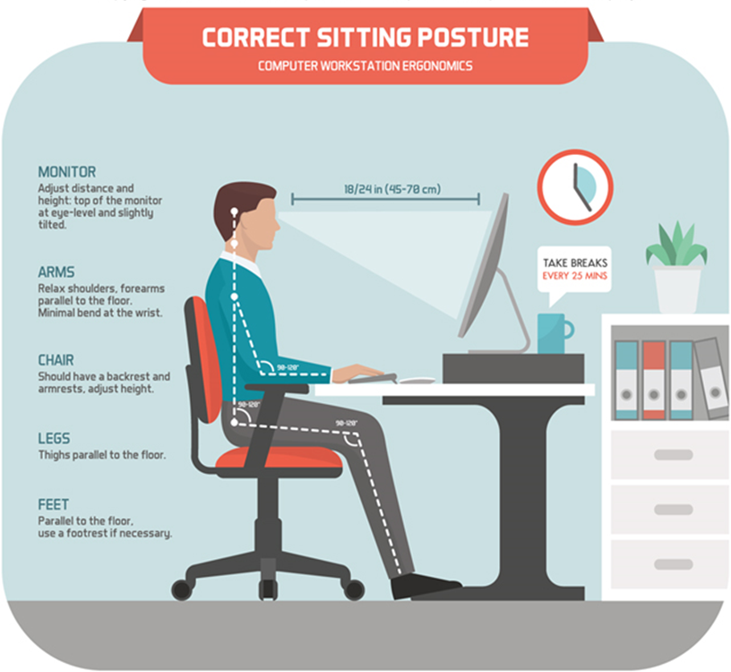
Ergonomics
Study of human factors related to things people use.
Fit the task to the user to avoid:
Eyestrain and headache.
Back and neck pain.
Repetitive strain injury.
Carpal tunnel syndrome.
Access the text alternative for slide images.
Wetcake Studio/Digital Vision Vectors/Getty Images
Notes:
Ergonomics (key term) – fitting the task to the user
Study to avoid :
Eyestrain (key term) and headache (key term) – 15 minute break every hour
Back and neck pain (key term) – equipment should be adjustable
Repetitive strain injury (key term) RSI (key term) – injury caused by repetitive injury
Carpal tunnel syndrome (Key term) – damage to nerves and tendons in hands

Slide 30
Ergonomic Challenged Devices
Portable devices are not set up for ergonomics.
Cell phones.
Pain in base of thumbs from being used to type on small screen keyboard.
Tablets.
Tablet hunch is caused by the user’s head being improperly aligned to the viewing surface.
Laptops.
Because the keyboard and monitor are connected, they cannot be set up ergonomically.
Akkraraj kangrang/Shutterstock; SNP_SS/Shutterstock; Microstocker13/Shutterstock
Notes:
Portable devices are not set up for ergonomics
Study to avoid :
Cell phones – avoid thumb strain by keeping wrists straight, head up and shoulders straight, and switch from thumbs to using other fingers to type
Tablets – avoid tablet hunch by taking frequent breaks or using a stand or external keyboard
Laptops – raise the level of the screen with books or reams of paper or connect an external keyboard

Slide 31
Careers in I T
Technical writers prepare instruction manuals, technical reports, and other scientific or technical documents.
Typically requires an associate’s or bachelor’s degree in:
Communications.
Journalism or.
English.
Specialization or familiarization with a technical field.
Technical writers can expect to earn $43,000 to $88,000 annually.

Slide 32
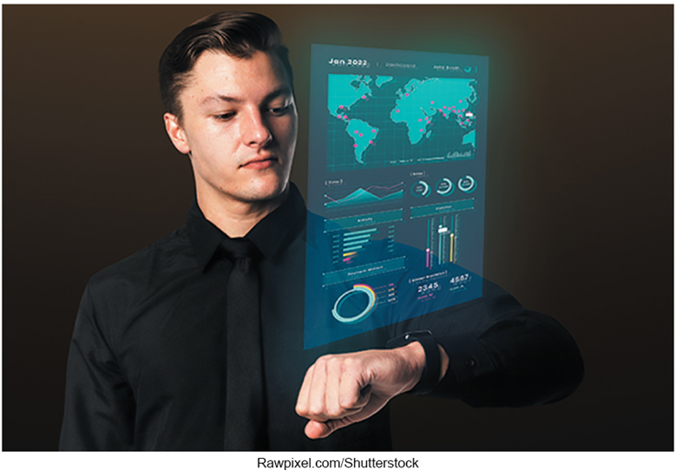
A Look to the Future
Internet of Things.
Smartwatch.
Can monitor and share your location.
Chips embedded in most items, including clothing.
Smart grocery cart.
Use grocery list to guide shopper through store and update total as items are put in the cart and process final bill.
Kirill Kedrinski/123RF
Notes:
Review page 153

Slide 33
Open Ended Questions
Define input and input devices.
Describe the different types of keyboard, pointing, scanning, image capturing, and audio-input devices.
Describe input and output devices.
Describe the features and different types of monitors and printers.
Describe audio output devices including Bluetooth technology.
Discuss combination input and output devices, including multifunctional devices, headsets, drones, robots, and virtual-mounted displays and controllers.
Define ergonomics, describe ways to minimize physical discomfort, and discuss design issues with portable computers.
Notes:
Have students turn to the end of Chapter 6 in their textbooks to view the same “Open-Ended” questions/statements

Slide 34
End of Main Content
© McGraw Hill LLC. All rights reserved. No reproduction or distribution without the prior written consent of McGraw Hill LLC.

